Slide 1
Serverless Azure functions
… in
PyLadies Amsterdam x LINKIT
Alyona Galyeva & Dana Arsovska
March 11th, 2020

Slide 2

outline
What's Cloud Computing?
Why Cloud Computing?
Azure Functions
Python Code Refactoring

Slide 3


Why cloud computing?
Assume you have an idea for an awesome application!
In order to reach your target audience you have to deploy it!

Slide 4




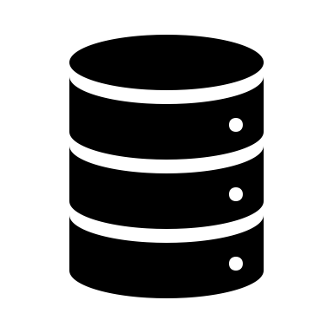
Why cloud computing?
To deploy your app you’ll need

Slide 5


Why cloud computing?
The initial setup is expensive
It is also risky!

Slide 6


What is cloud computing?
Cloud computing is a platform that provides access to computing resources over the internet.
User
Cloud
Resources
VMs
Storage

Slide 7



Why cloud computing?
Datacenters
Cloud providers own massive datacenters with hundreds of
servers and storage systems
Services
Cloud providers offer many cloud computing services
Cost effective
Users only pay for the services they use.

Slide 8
What is cloud computing?
Cloud computing services include:
Data storage and backup
Compute power
Analytics
Streaming content
Hosting
Application testing and deployment

Slide 9
What is Azure?
Azure is an ever-expanding set of cloud computing services provided by Microsoft.

Slide 10

Azure Services – Compute
Azure Functions: Easily build applications using serverless functions.

Slide 11
Azure Functions

Slide 12
What you need to consider?
Serverless is not right for every project
- You want control
- Your workloads are constant
- You have long running functions
- You use unsupported language
Structure you code following best practices & Optimize your code for the billing model
Log everything

Slide 13
Best Practices for Writing Azure Functions in Python

Slide 14

Best Practices
def get_max_d_from_df(df): pass
The function should:
Have a sensible name
def get_max_number_of_days(dataframe): pass

Slide 15
Best Practices
The function should:
Have a reasonable name
Single responsibility
def calculate_and_print_stats(list_of_numbers): sum = sum(list_of_numbers) mean = mean(list_of_numbers) median = median(list_of_numbers) mode = mode(list_of_numbers) print('-----------------Stats-----------------') print('SUM: {}'.format(sum) print('MEAN: {}'.format(mean) print('MEDIAN: {}'.format(median) print('MODE: {}'.format(mode)

Slide 16
Best Practices
The function should:
Have a reasonable name
Have a single responsibility
Be short (and readable)
Red flags:
You can't immediately determine the function's purpose
Deeply nested control structures
Logic that is duplicated in other methods
Your massive developer-grade display isn't big enough to display it

Slide 17
Best Practices
The function should:
Have a reasonable name
Have a single responsibility
Be short
Be idempotent

Slide 18
Best Practices
The function should:
Have a reasonable name
Have a single responsibility
Be short
Be idempotent
Finish as quickly as possible

Slide 19
Best Practices
The function should:
Have a reasonable name
Have a single responsibility
Be short
Be idempotent
Finish as quickly as possible
Avoid (or set up the depth of) recursions

Slide 20
Best Practices
The function should:
Have a reasonable name
Have a single responsibility
Be short
Be idempotent
Finish as quickly as possible
Avoid (or set up the depth of) recursions
Be stateless

Slide 21
Best Practices
The function should:
Have a reasonable name
Have a single responsibility
Be short
Be idempotent
Finish as quickly as possible
Avoid (or set up the depth of) recursions
Be stateless
Include a docstring

Slide 22
Best Practices
The function should:
Have a reasonable name
Have a single responsibility
Be short
Be idempotent
Finish as quickly as possible
Avoid (or set up the depth of) recursions
Be stateless
Include a docstring
Defensive functions

Slide 23
Is my app/workload right for serverless?
Let’s dive in…

